Slide 1


Give an Hour…Make a Difference
Presenter Name
Date

Slide 2
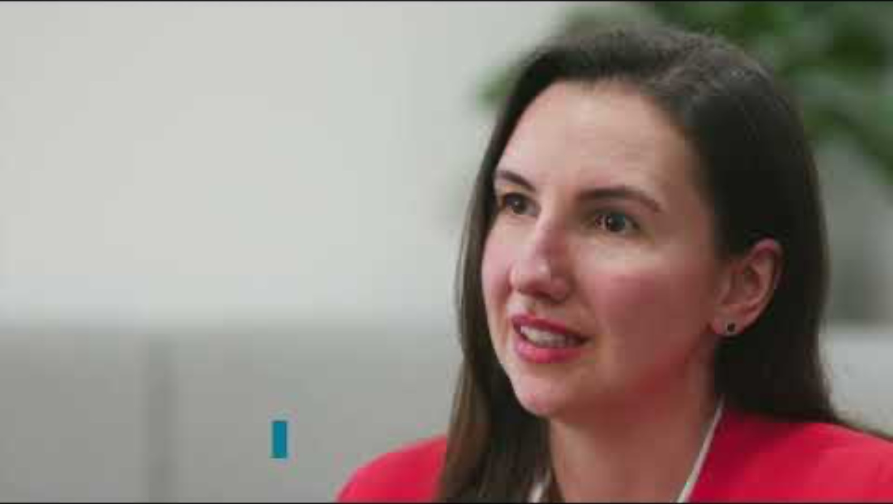
GIVE AN HOUR PROGRAMME
Campaign Video
Notes:
Hyperlink embedded in image to campaign video

Slide 3
GIVE AN HOUR PROGRAMME
Introduction
The Give an hour offer is a collaborative effort between The Careers & Enterprise Company, Careers Hubs and industry partners.
Our goal is to inspire entrepreneurs and small businesses to engage with and support young people in schools and colleges by providing valuable career-related activities.
The Give an hour resource has been designed to show you that you do not have to give up a lot of time to make a big difference.
Notes:
The Give an Hour Campaign is asking those who work for, or own small or medium sized businesses to inspire and support the young people in local schools and colleges, by sharing their unique stories and knowledge of their industry, along with the skills they use in their role day to day.
We know from experience that interactions with people from business and industry can have a big impact in the future career choices that a young person makes.
With the Give an hour campaign, we aim to introduce young people to a wider variety of options and careers experiences.

Slide 4
GIVE AN HOUR PROGRAMME
Why get involved
94%
96%
41%
Nine in ten businesses know they have skills gaps to address
Who volunteer their time in schools and colleges say business involvement in education is a good way to close skills gaps
Nearly half of Year 11 students are not confident talking about their skills in an interview
Notes:
Sources:
Research from CBI: https://www.cbi.org.uk/media/skznxy0q/education-and-skills-survey-2022.pdf
https://www.careersandenterprise.co.uk/news/businesses-say-working-with-schools-helps-close-skills-gaps/
FutureSkills survey: https://www.careersandenterprise.co.uk/our-evidence/evidence-and-reports/fsq-insight-briefing-2022-2023/

Slide 5
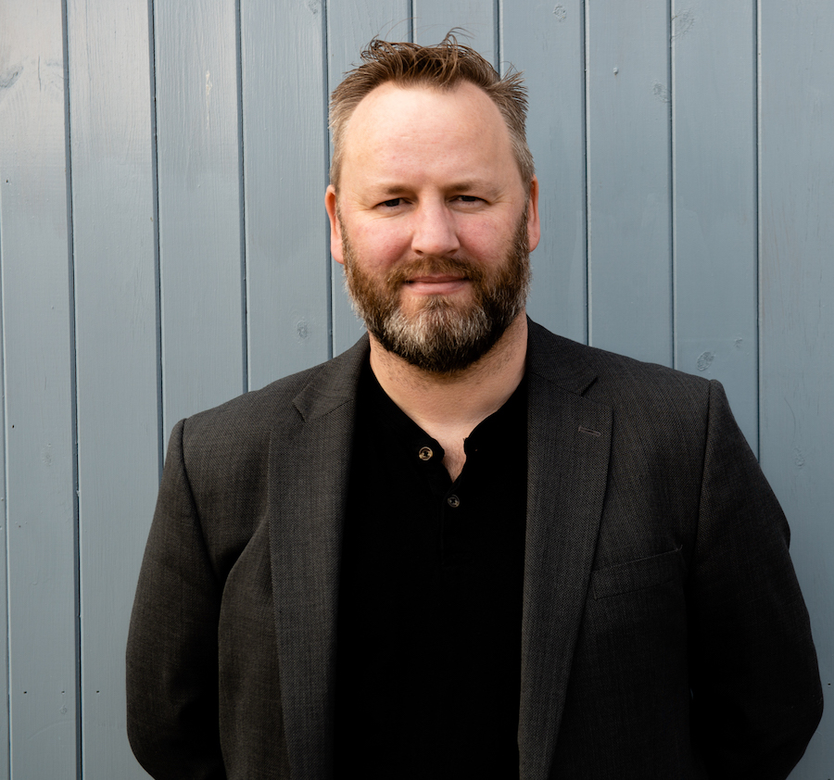
GIVE AN HOUR PROGRAMME
Benefits to your organisation
…getting involved with local schools and colleges include:
An opportunity to give back to your local community.
A chance to inspire and energise young people in your area about the world of work.
Build a future talent pipeline.
Give young people a better understanding of your industry.
Develop and engage your current workforce.
“Once you start working in a school and can see the difference you’re making, there’s no better reward. I couldn’t be prouder of the small part I am playing to help change the lives of young people”
Richard Osborne, Founder and CEO of Business Data Group Ltd

Slide 6





GIVE AN HOUR PROGRAMME
What can you do in an hour?
An hour can make a big difference to the life of a young person.
What can you do in an hour? A lot!
Speak
Share
Workshop
Networking
Activities
Share your career story to a class or assembly
Run a group session about your industry or workplace
Carry out a mock interview or preparing for application workshop
Answer young peoples’ questions about your career
Get you and your staff involved in volunteering with local careers activity providers
Content

Slide 7
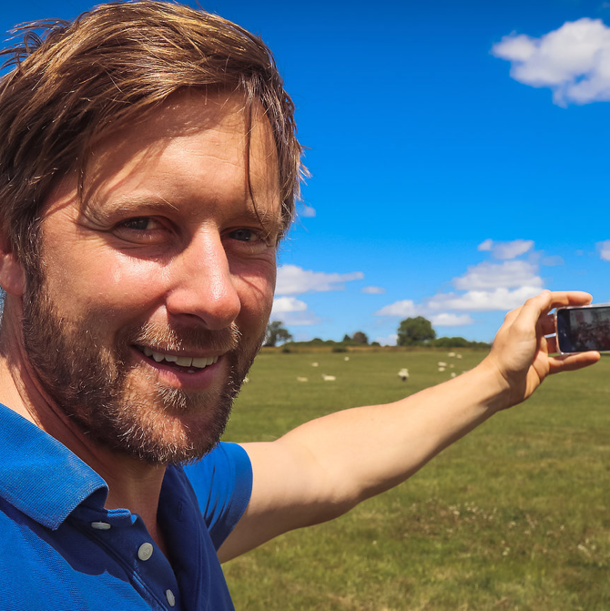
GIVE AN HOUR PROGRAMME
You can be creative
“By using technology, it doesn’t even need to take an hour! Our 150 farmers use FaceTime or Skype to connect with 150 classrooms every fortnight, giving the young people an insight into farming and rural life, which links to the curriculum and wider career opportunities.”
Tom Martin – Farmer and founder of FaceTime a Farmer

Slide 8


GIVE AN HOUR PROGRAMME
Sign up, what happens next?
01.
02.
03.
Register your interest online
Local Enterprise Coordinator will make contact to discuss the opportunities available locally
Supported by the local team, you’ll deliver a careers activity in a school or college

Slide 9
GIVE AN HOUR PROGRAMME
You can help to inspire
“During our sessions the young people get very enthused and ask the most unusual and wonderful questions, which in turn inspires and motivates the team for weeks and helps us to shape the end product.”
Lorena Puica – Founder CEO, iamYiam

Slide 10
Visit
careersandenterprise.co.uk/give-an-hour
to register and find out more

