Slide 1
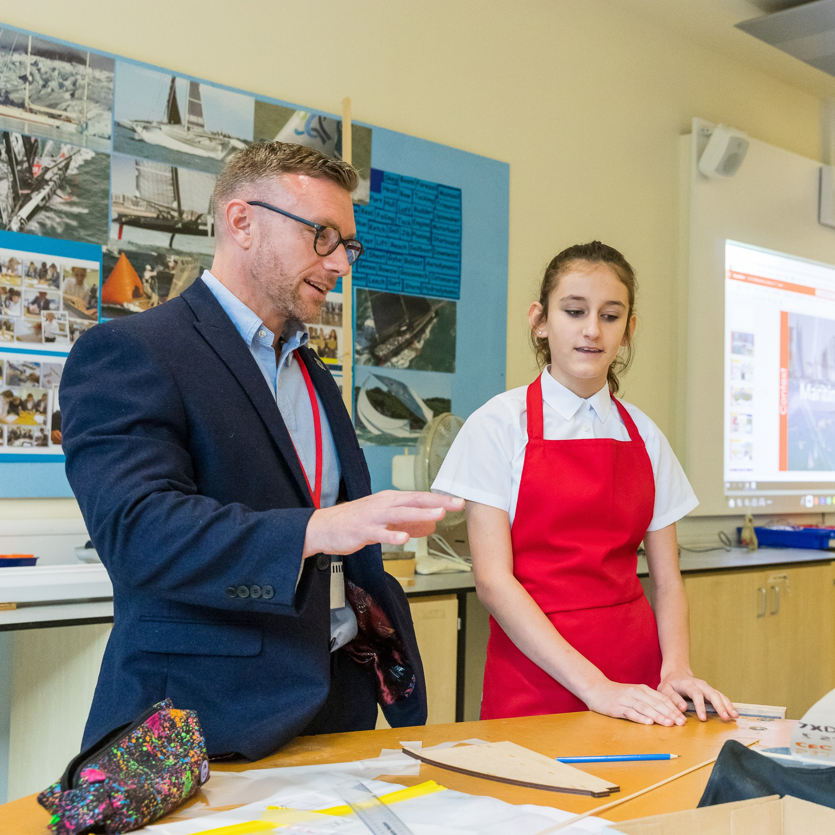
In an hour, you could change a young person’s life just by helping them understand more about the world of work
Register to make a difference at: careersandenterprise.co.uk/give-an-hour

